Slide 1
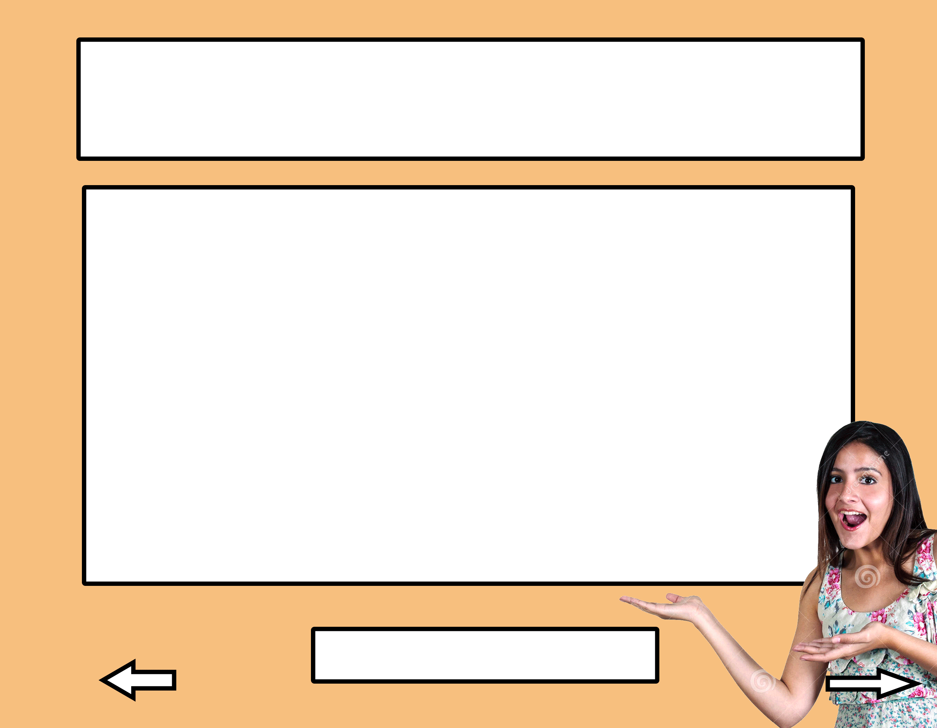
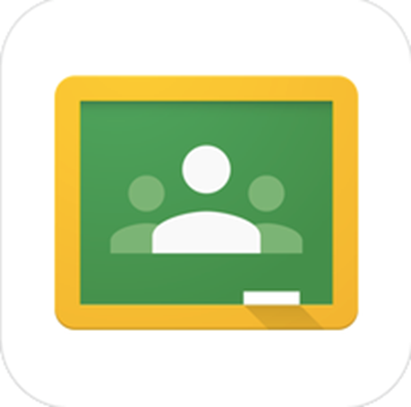

Google Classroom Tutorial
www.p3edtech.com

Slide 2
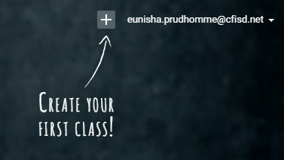
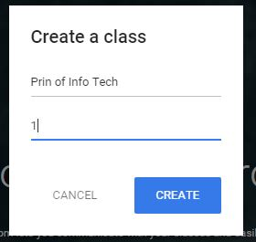
Create a Class
1
2
From the drop-down, click on “Create Class”
3
Type in name of course and section, then click “Create”
www.p3edtech.com

Slide 3
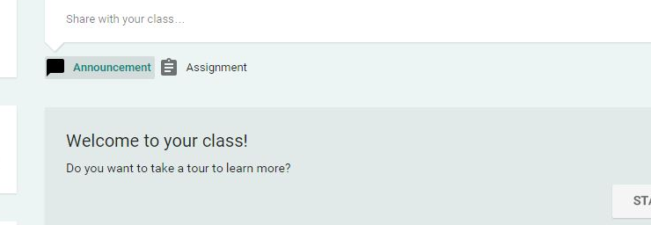
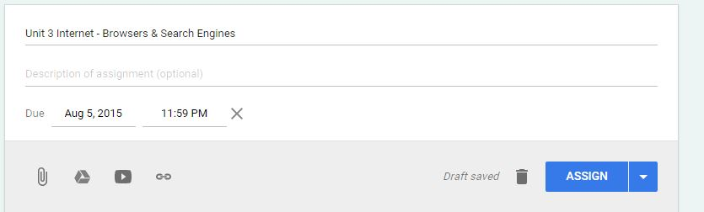
Add Assignment
1
Click on "Assignment”
2
Add description and due date
3
Add extras
www.p3edtech.com

Slide 4
About Those Extras
Upload attachment from computer
Attach a file from your Google Drive
Link a YouTube Video
Link to a website
www.p3edtech.com

Slide 5
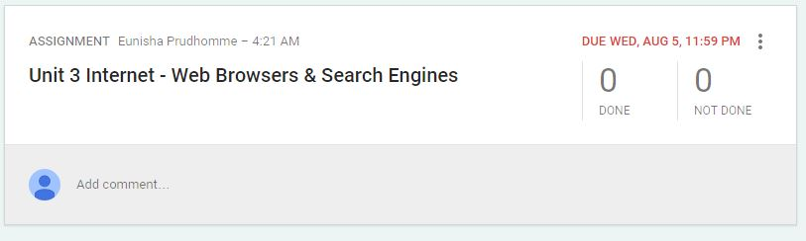
Finish Adding Assignment
Click “Assign”
Click here to edit or delete assignment
Add comments
www.p3edtech.com

Slide 6
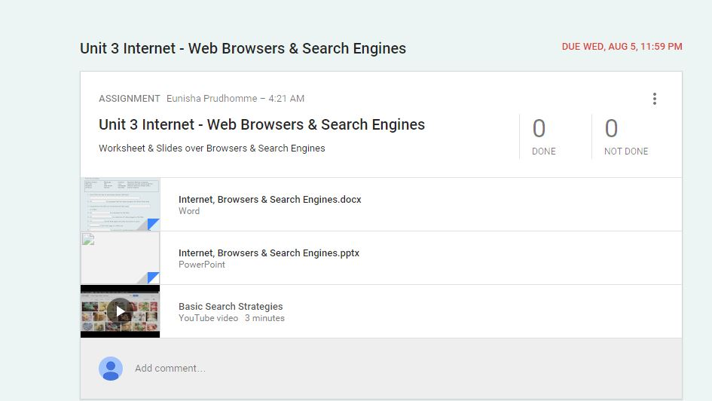
Finalized Lesson
www.p3edtech.com

Slide 7
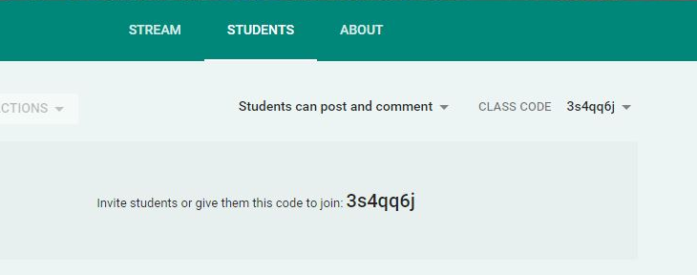
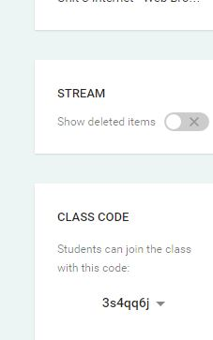
Add Students
Easiest method – Click on “Students” and Give students the “class code”.
Set permissions
www.p3edtech.com

Slide 8
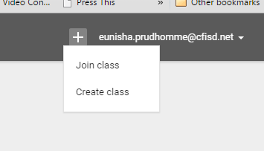
How Do Students Use the Code?
Students go to: www.classroom.google.com
Click +
Click on “Join Class” and enter the class code
www.p3edtech.com

Slide 9
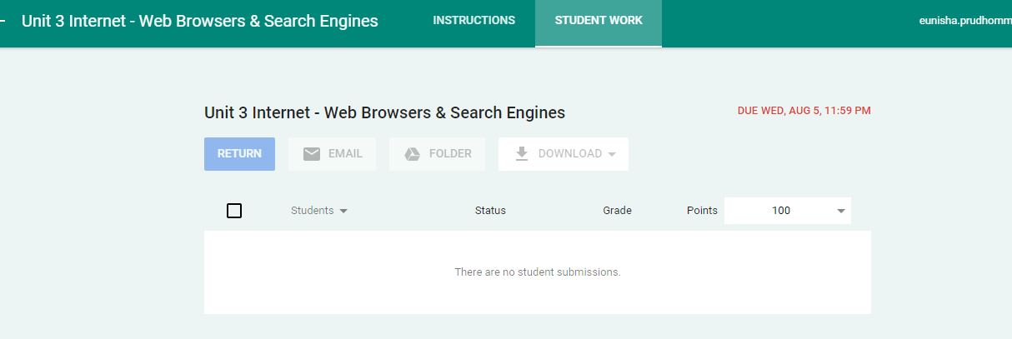
View, Grade & Return Submissions
Return graded work and feedback to student
Set point value
www.p3edtech.com

Slide 10
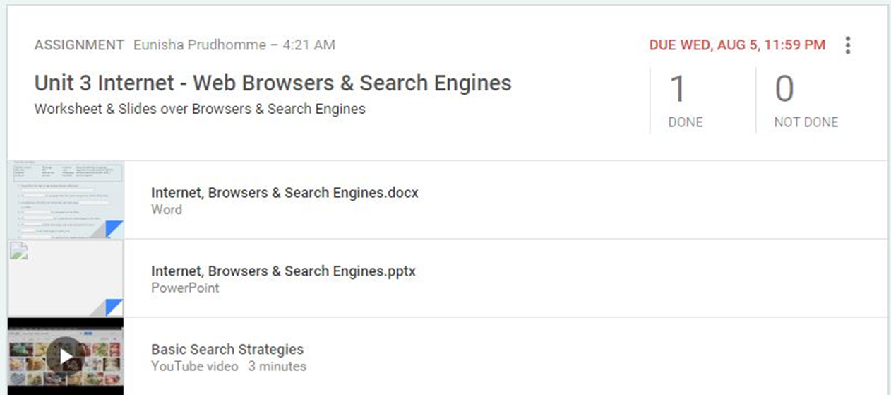
Assignment Completion Status
www.p3edtech.com

Slide 11
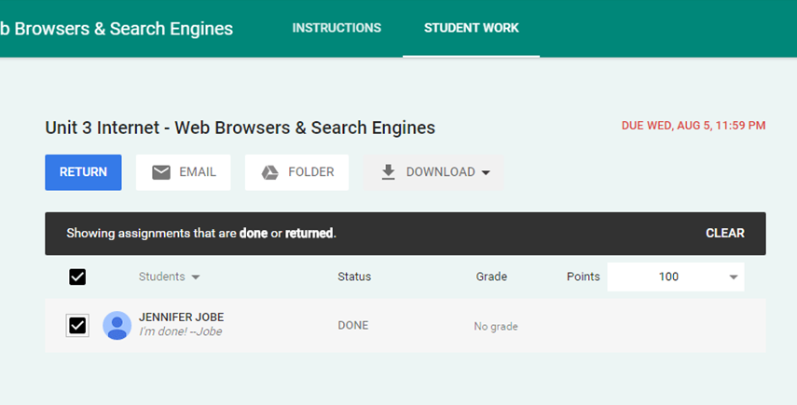
Submitted Assignment
Download and save submission
Click on student’s name to open submission
www.p3edtech.com

Slide 12
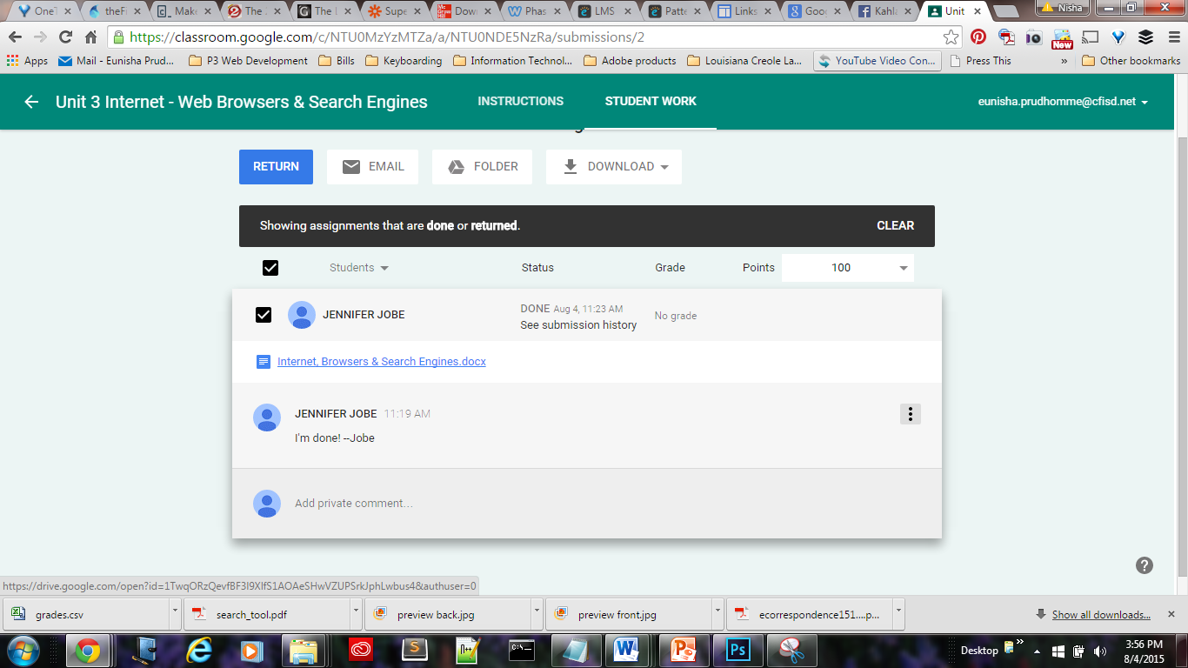
Send Feedback Privately
www.p3edtech.com

Slide 13
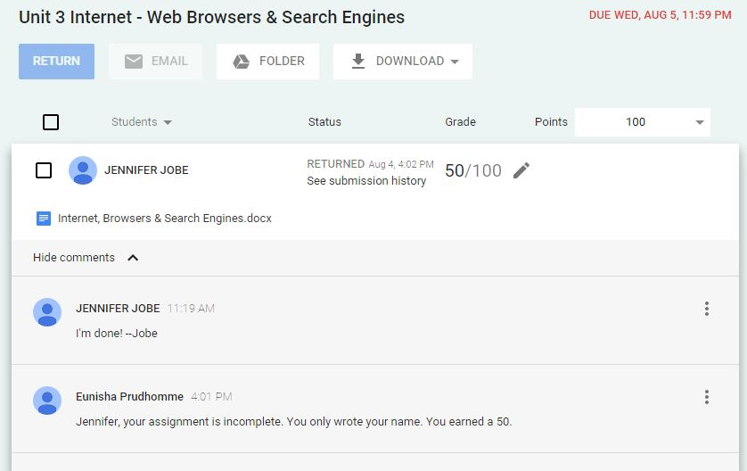
Send Feedback
www.p3edtech.com

Slide 14
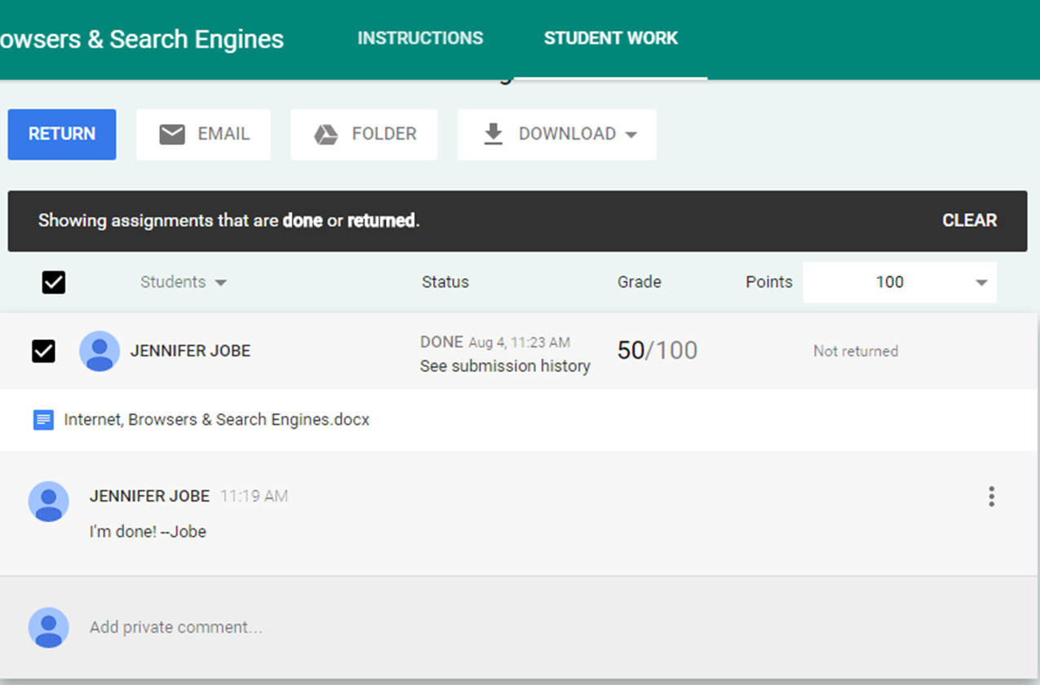
Assign Grade and Return Work
Click here and type in grade
www.p3edtech.com

Slide 15
Thank you for viewing
Feel free to browse my TpT Store for other technology resources and teacher tools.
You can also visit my blog for additional resources and Tech Integration tips
at: www.p3edtech.com
- Nisha
www.p3edtech.com

